Slide 1
Dotnet core on PKS
Application Transformation Core Engineering Practice Talk
Version 1.0
May 2018

Slide 2

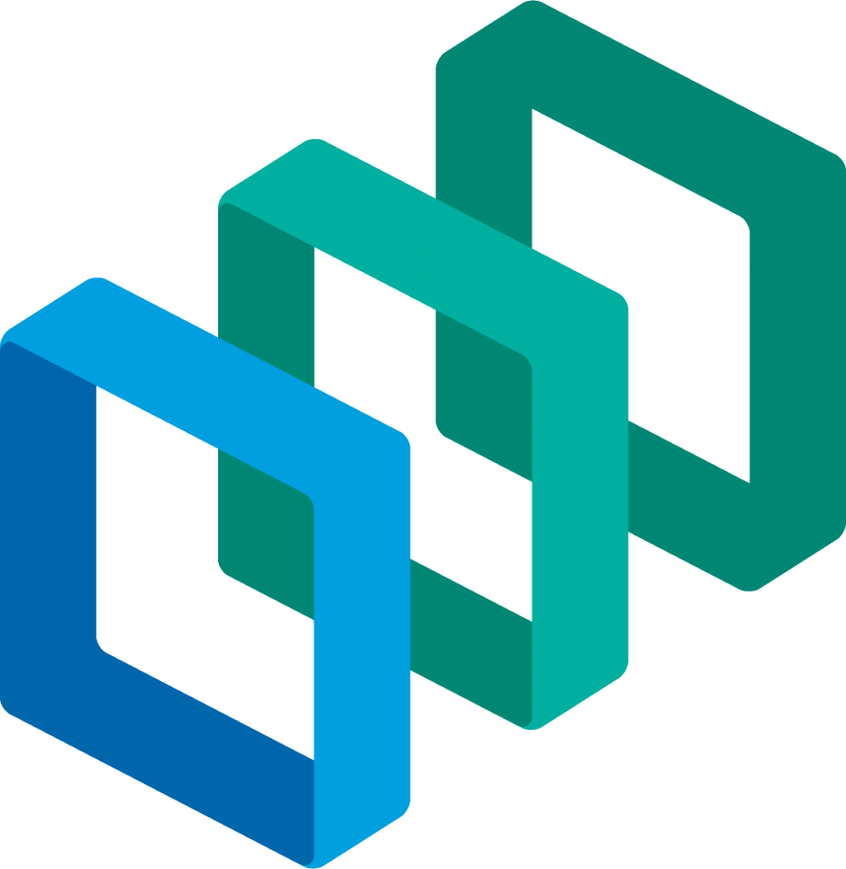

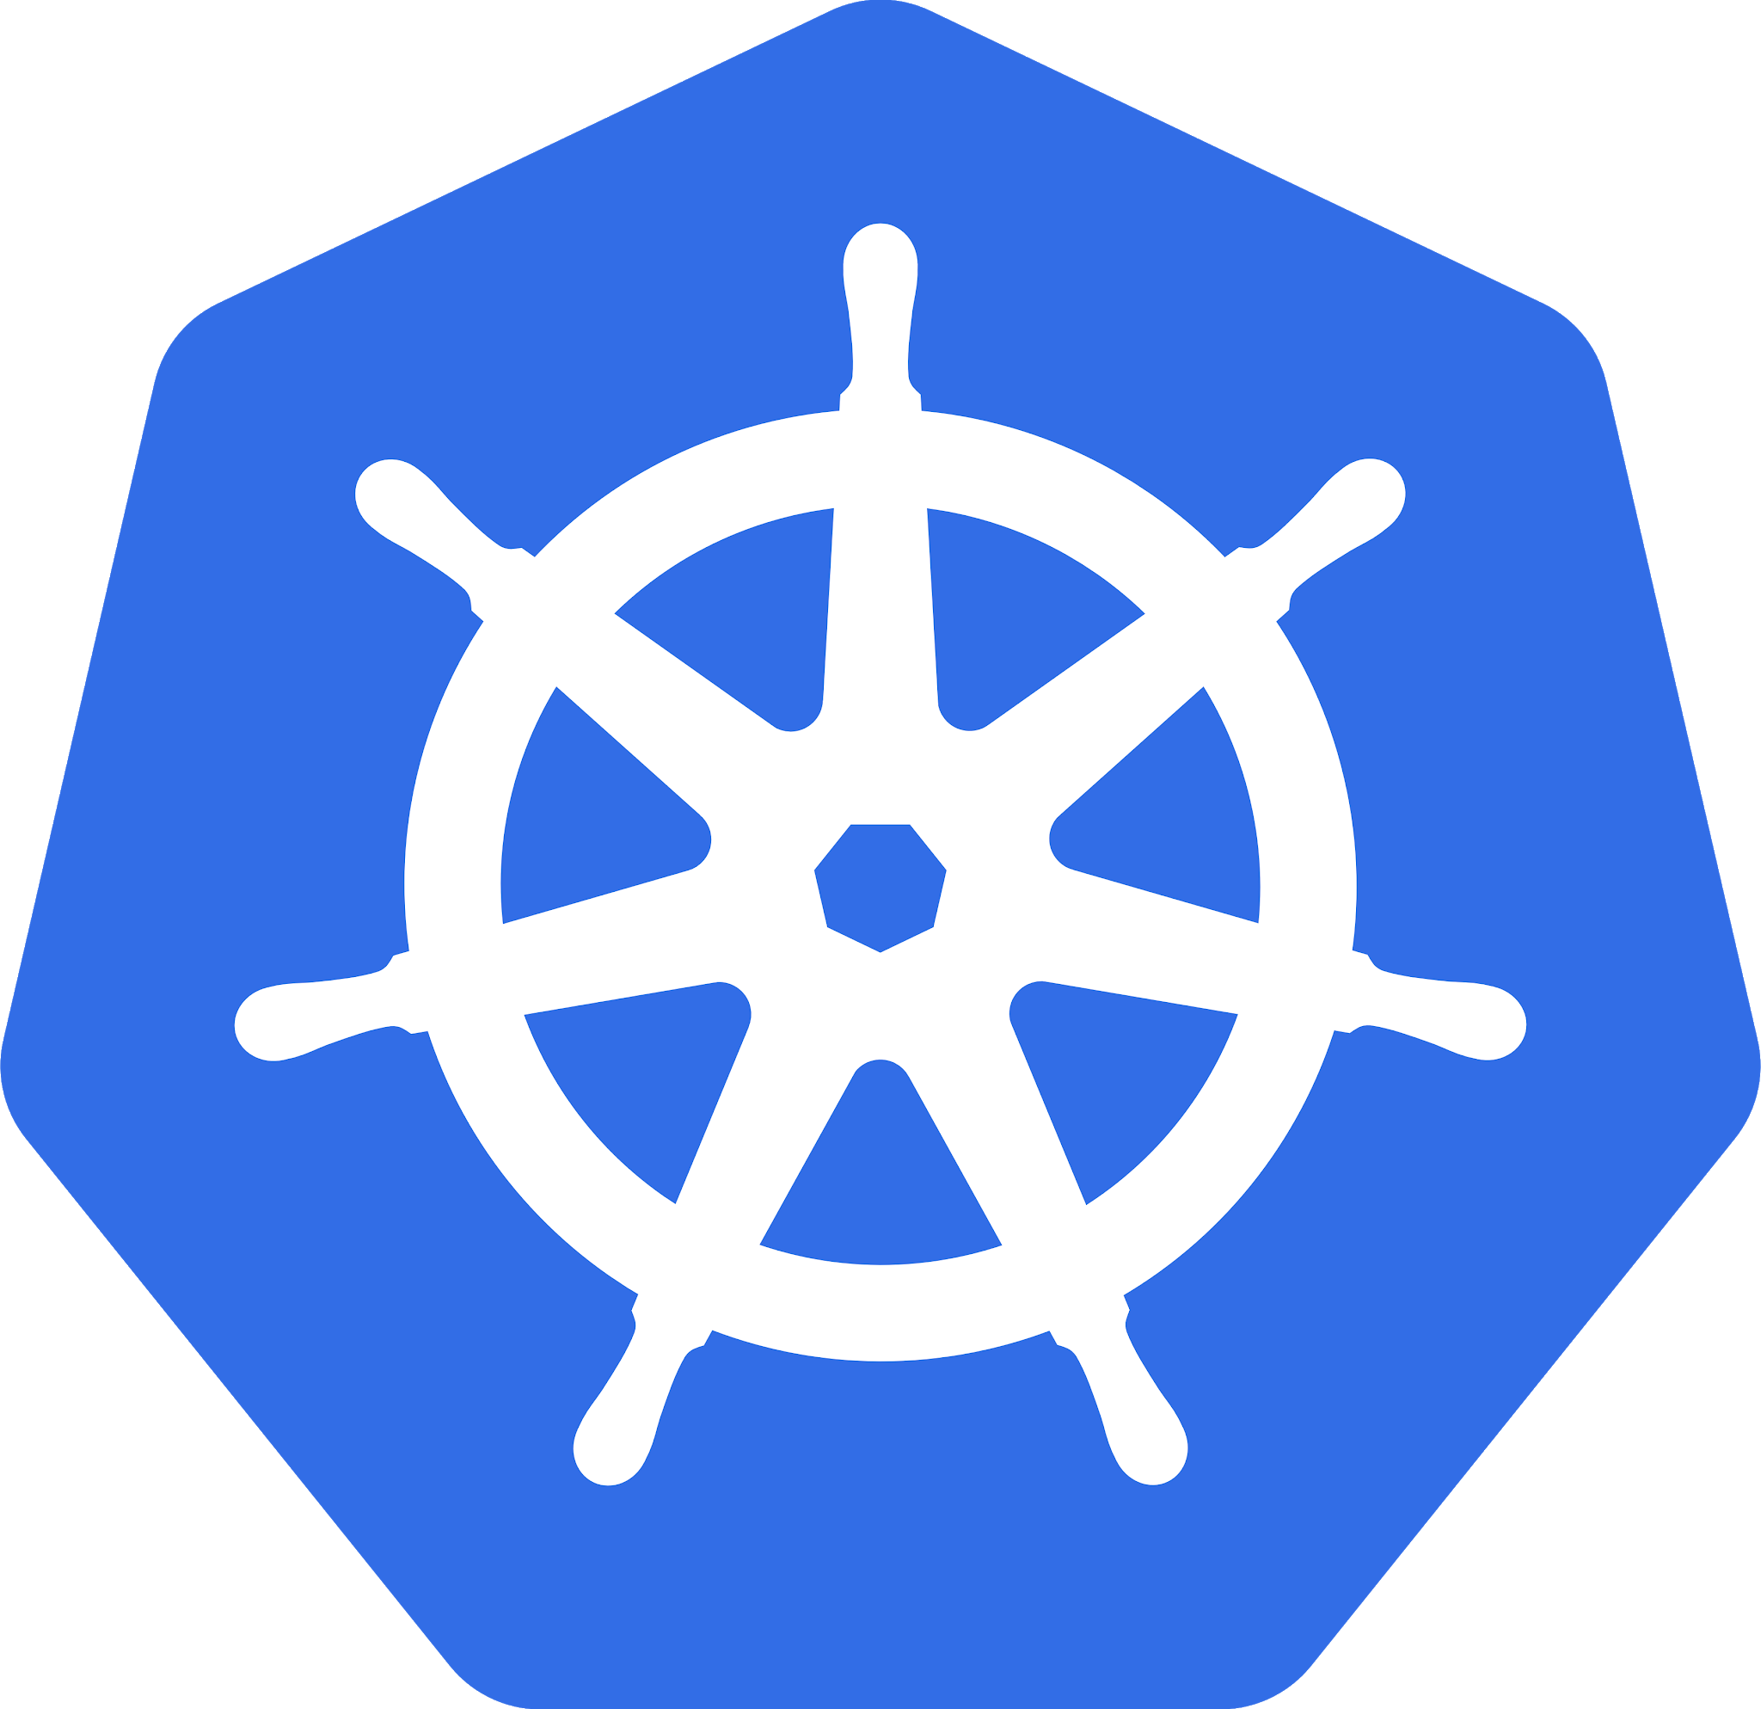
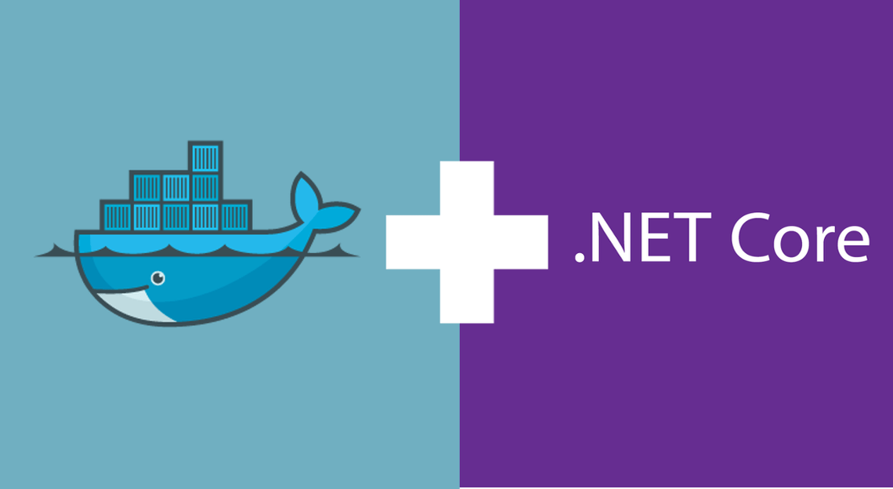
Overview
Manual Install of PKS on GCP Sneak peek at manual installation of PKS on GCP.
Install Harbor tile on GCP Brief discussion about installation of Harbor on GCP and integrating it with PKS.
Network Topology Overview of the network topology of PKS demo environment.
Dockerize and push images Dockerize dotnet core applications and push the images to Harbor.
Deploy and run dotnet microservices in PKS Deploy and test dotnet micro services on PKS.
Agenda

Slide 3
Manual Install of PKS on GCP

Slide 4
Manual Install of PKS on GCP
GCP Account
DNS
If you have a domain registered with GoDaddy.
Create Cloud DNS zones in GCP
pcf-zone, pks-zone, harbor-zone
Create NS records in GoDaddy for the sub-domains matching values from the GCP Cloud DNS zones mentioned above.
Create master and worker node service accounts in GCP (IAM & admin → Service Accounts)
Create the required subnets inside your virtual network
Create the NAT instance VMs and corresponding routes
Create the firewall rules for the network
Prerequisites
References
https://docs.pivotal.io/runtimes/pks/1-0/gcp-prepare-env.html

Slide 5
Manual Install of PKS on GCP
Steps
Install OpsManager
https://docs.pivotal.io/runtimes/pks/1-0/gcp-om-deploy.html
Configure BOSH Director on GCP
https://docs.pivotal.io/runtimes/pks/1-0/gcp-om-config.html
Install and configure PKS tile
https://docs.pivotal.io/runtimes/pks/1-0/installing-pks-gcp.html
Install Steps

Slide 6
Install Harbor Tile on GCP

Slide 7
Install Harbor tile on GCP
Steps
Download Harbor tile from Pivnet
Upload the tile to Opsman
Configure Harbor tile as per the below link
https://docs.pivotal.io/partners/vmware-harbor/installing.html
Integrate Harbor with PKS
Download the Root Certificate
Adding it to Trusted certificates of Opsman
Install and Integrate Steps

Slide 8
Manage PKS clusters

Slide 9
Manage PKS clusters
uaac
Used to interact with UAA server to manage users. gem install cf-uaac
pks
Command line client to manage PKS clusters. It’s a single binary and can be downloaded from https://network.pivotal.io/products/pivotal-container-service
kubectl
This is the main tool for interacting with kubernetes clusters. Install it by running: brew install kubectl
CLI tools

Slide 10
Manage PKS clusters
Configure PKS api access
uaac target api.pks.smanyamr.com:8443 --skip-ssl-validation
uaac token client get admin -s uN85htaJ4ZdKGqD8FamhmjF_c90eR2Fv (uN85htaJ4ZdKGqD8FamhmjF_c90eR2Fv is from Ops Manager > Pivotal Container Service > Credentials > Uaa Admin Secret)
uaac user add <<userid>> --emails <<email-id>> -p <<password>>
uaac member add pks.clusters.admin <<userid>>
Login to PKS
pks login -a api.pks.smanyamr.com -u <<userid>> -p <<password>> -k
pks create-cluster dotnetcore-101 --external-hostname dotnetcore-101.pks.smanyamr.com --plan small
pks cluster dotnetcore-101
Put the master vm behind load balancer
Create a firewall rule to expose 8443
Target a cluster on PKS
pks get-credentials dotnetcore-101
Create PKS user

Slide 11
Network Topology

Slide 12
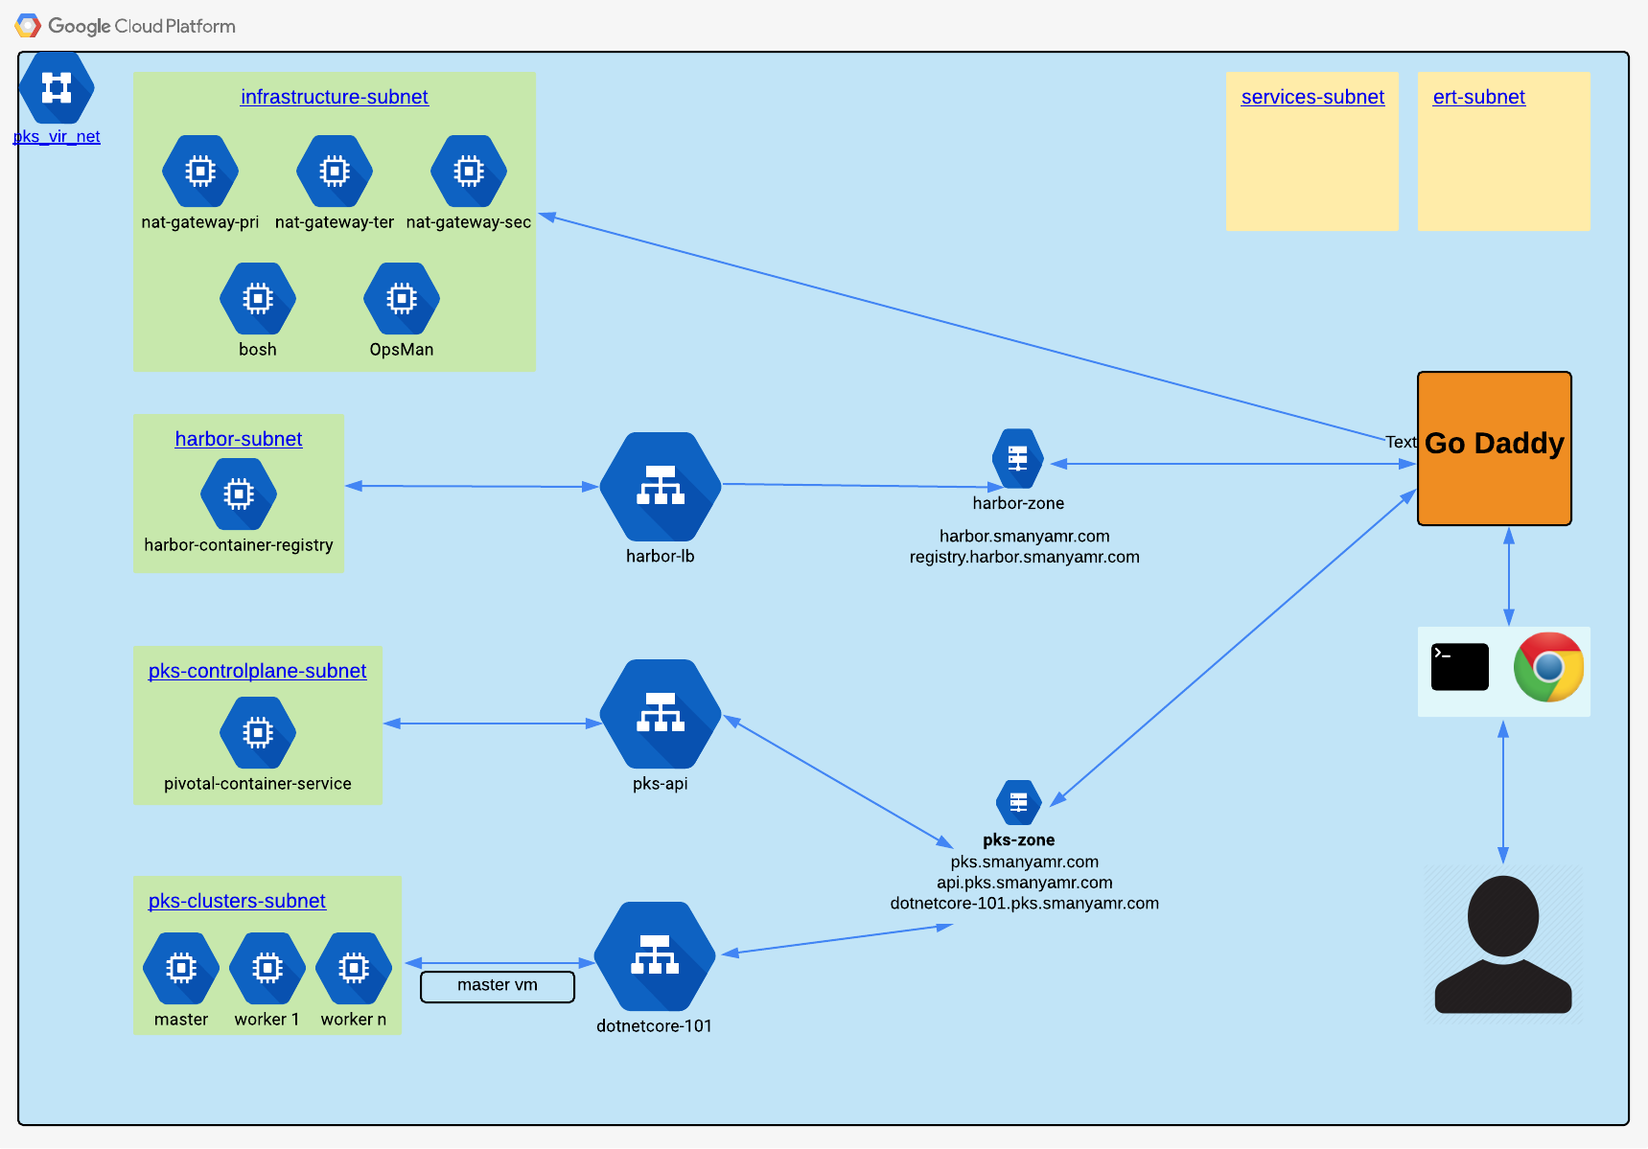
Network Topology

Slide 13
Dockerize & push images

Slide 14
Dockerize & push image
Install dotnet core
https://www.microsoft.com/net/download/macos
Install VSCode
https://www.microsoft.com/net/download/macos
Install Docker
https://store.docker.com/editions/community/docker-ce-desktop-mac
Clone the repo
https://github.com/sreenivasmrpivot/DotnetCoreOnPKS
Prerequisites

Slide 15
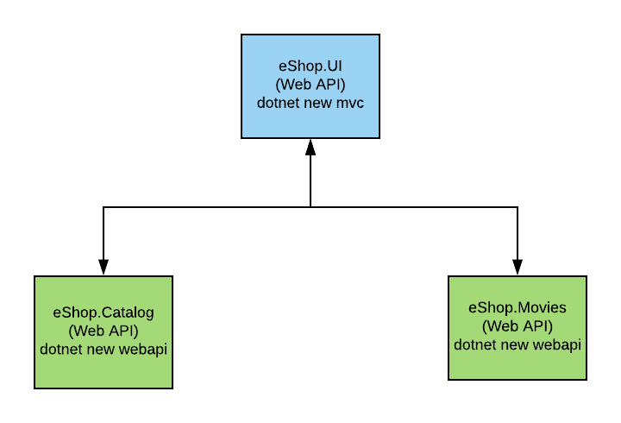
Dockerize & push image
Solution Overview

Slide 16
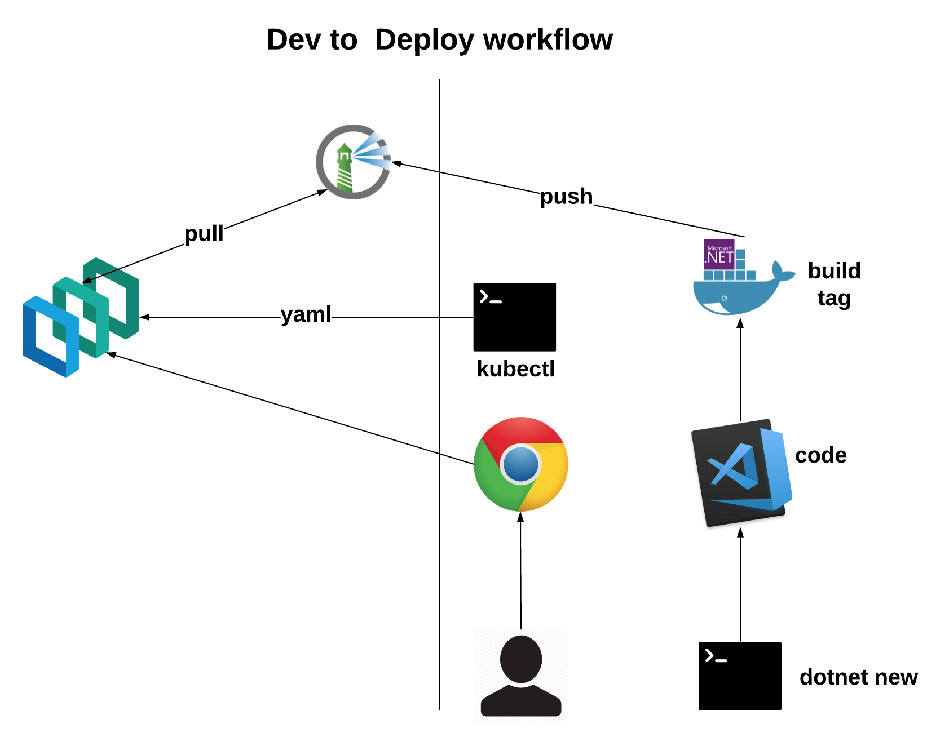
Dockerize & push image
Dev to Deploy

Slide 17
Dockerize & push image
Login to Harbor
docker login registry.harbor.smanyamr.com
Build image
docker build -t eshop.ui .
Tag image
docker tag eshop.ui:latest registry.harbor.smanyamr.com/dotnetcore-101/eshop.ui:v1.0.0
Push image
Create a project called dotnetcore-101 in Harbor
docker push registry.harbor.smanyamr.com/dotnetcore-101/eshop.ui:v1.0.0
Create docker registry secret
kubectl create secret docker-registry smanharborconsecret --docker-server="registry.harbor.smanyamr.com" --docker-username=”<<username>>" --docker-password=“<<password>>" --docker-email=“srajaram@pivotal.io”
Prerequisites

Slide 18
Deploy & run dotnet micro services in PKS

Slide 19
Deploy & run dotnet micro services in PKS
Deploy dotnet micro services
kubectl apply -f eShop.kubes.pks.yaml
Run and test dotnet micro services

Slide 20
Next iteration goals

Slide 21
Next iteration goals
ConfigMaps externalize config for dotnet core micro services on PKS
Service Discovery for dotnet core micro services on PKS
UAA for dotnet core micro services on PKS
Deploy api gateway for dotnet core micro services on PKS
https://www.getambassador.io/
Move PAL .NET micro services to PKS an add to PAL content if required

Slide 22

Transforming How The World Builds Software
© Copyright 2017 Pivotal Software, Inc. All rights Reserved.

